Slide 1



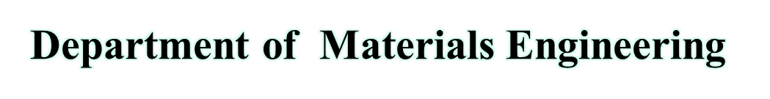
Thermoplastics polymers

Slide 2
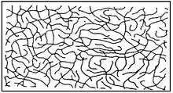
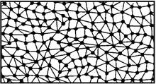
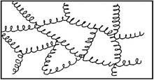
Plastics - Classification
Thermosets
Thermoplastics
Elastomers

Slide 3
thermoplastics
thermoplastics are solid materials at room temperature but viscous liquids when heated to temperatures of only a few hundred degrees
This characteristic allows them to be easily and economically shaped into products They can be subjected to heating and cooling cycles repeatedly without significant degradation
Symbolized by TP.
Notes:
Plastics can comprise both linear chains and also branched and crosslinked chains.
The chain length and the branches define not only the composition but also the main characteristics of the individual materials.

Slide 4
thermoplastics
A thermoplastic, also called a thermo-softening plastic is a plastic which becomes pliable مرنة or moldableقابلة للتشكيل above a specific temperature and returns to a solid state upon cooling.
•Most thermoplastics have a high molecular weight.
•Polymers which molds above Glass transition temperature and returns to normal state upon cooling.
•CHARACTERISTIC: More aestheticallyجمالي وجذاب pleasing, Stronger and stiffer but lower toughness, expensive forming processes, less resistance to mechanical creep, not suitable for use in extremely temperatures, little to no cross-linking in microstructure, eco-friendly forming process.عمليات تشكيله صديقة للبيئة

Slide 5
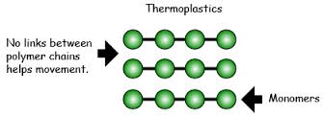
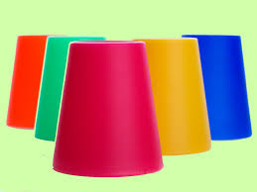
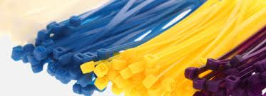
Thermoplastics
Polymers which moulds above Glass transition temperature and returns to normal state upon cooling is called thermoplastics polymers

Slide 9
Thermoplastics
Most commonly used engineering thermoplastics as matrices
اللدائن الحرارية الهندسية الأكثر استخدامًا كخلائط او في مواد مركبة
  Nylon
  Polycarbonate (PC)
  Polyethylene terephthalate (PET)
  Polypropylene (PP)
Stronger and stiffer اكثر صلابة but lower toughness متانه
Have engineering as well as advanced applications.تمتلك تطبيقات هندسية ومتقدمة

Slide 10
Properties of thermoplastics
•Tough
•lightweight material that is resistant to acids and bases.
•High hardness
• high modulus of elasticity (rigid-type), very low modulus of elasticity (flexible)
•Poor heat stability, small expansion coefficient
•Good flame retarding(delaying)
•Electrical insulator
• Can be remolded and recycled

Slide 11
Types of thermoplastics polymers
• Polyvinyl chloride(PVC).
– It is a tough, lightweight material that is resistant to acids and
bases.
– Much of it is used by the construction industryصناعة البناء , such as for
vinyl siding, drainpipes, gutters and roofing sheets.
– It is also converted to flexible forms with the addition of
plasticizers, thereby making it useful for items such as hoses,
tubing, electrical insulation, coats, jackets and upholstery.
– Flexible PVC is also used in inflatable products, such as water
beds and pool toys.
• Poly-propylene.
– It is useful for reusable plastic food containers, microwave- and
dishwasher-safe plastic containers, casing اغلفة, ropesحبال , carpets,
plastic moldings, piping systems, car batteries, insulation for
electrical cables and filters for gases and liquids.
– It is also used for making heat-resistant medical equipment.
– Polypropylene sheets are used for stationery folders مجلدات القرطاسية and
packaging and clear storage bins.

Slide 12
Types of thermoplastics polymers
• Poly-ethylene
– It is used to manufacture moving machine partsاجزاء المكائن المتحركة , bearings, gears, artificial joints and some bulletproof vests.
– High-density polyethylene (HDPE), recyclable plastic no. 2, is commonly used as milk jugs, liquid laundry
detergent bottlesزجاجات المنظفات, outdoor furniture, margarine tubsاحواض الدهون ,
portable gasoline cans, drinking water distribution
systems, water drainage pipes, and grocery bags.
– Medium-density polyethylene (MDPE) is used for
packaging film, sacks and gas pipes and fittings
• Methacrylate.
– It serves as a sturdy substitute for glass for itemsبديل مناسب جدا للزجاج such as aquariums, motorcycle helmet visors tahdid, aircraft
windows, viewing ports of submersibles, and lenses of
exterior lights of automobiles.
– In medicine, it is used in bone cement and to replace
eye lenses.
– Acrylic paint consists of PMMA particles suspended in
water.

Slide 13
APPLICATION Methacrylate
• AS A BUILDING MATERIAL
Construction professionals select plastic materials based on the following criteria:
1. Durability: متانه
Plastic hardware is corrosion resistant and hence can survive harsh weather.
conditions. تقاوم عوامل الجو القاسية
2. Cost Effectiveness
3. Recyclable: To reduce harmful waste accumulation on the site.
4. Energy Saving:
Plastic consumes less heat than metal, hence the insulating effects of some plastics can decrease sound pollution level.
5. Ease of installations.سهولة التركيب
6. Maintenance required- less.صيانه اقل

Slide 14
APPLICATION
7. Domes and Skylightالقباب والمناور
8. Roofingتسقيف
9. Windows and Doors
– Polycarbonate
a material also used in eyeglasses is used as panes(parts). These are clear, lightweight, shatter-resistantمقاومة للكسر plastic products have low thermal conductivity, which can help to reduce heating and cooling costs.
– Vinyl window frames are inherently(naturally) energy
efficient and can save trillion thermal units of
energy per year, helping reduce the
greenhouse gas emissions associated with
energy generation—all the while cutting
maintenance time, materials and costs.
10. Hardware Accessories–Washers, nuts, bolts, sleeves, anchoring wires.

Slide 15
APPLICATION
Flooring :الارضيات
Thermoplastic vinyl tiles – these tiles are laidتوضع on dry and clean floor on cut back bitumen adhesives spread and rolled with light rollers. These tiles are unaffected by water , oil and greaseالشحوم .
PVC Sheets – 1mm thick and are provided with cheaper backing material. For better adhesion these sheets are roughened on the under side.
– Flooring tiles and rolls.
Temporary Structures
Guard cabinsكبائن الحراسة, tents.
Decorated Laminated Plastic Sheet
Tough , durable , available in variety of colour and texture.

Slide 16
Effect of temperature
Above glass-transition temp. – polymers become leathery and then rubbery
At higher temperatures, polymers become a viscous fluid, with viscosity decreasing with increasing temperture.

Slide 17
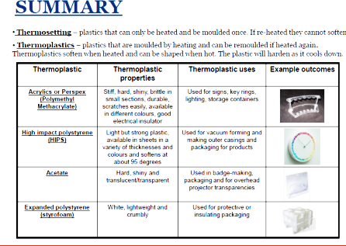

Slide 18
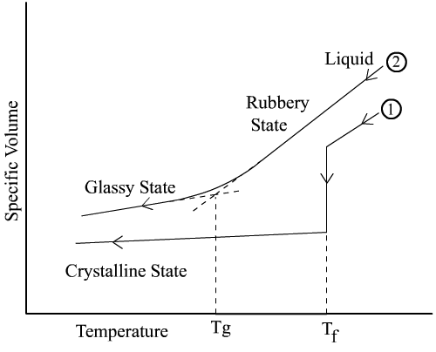
Glass transition temperature
Amorphous polymers do not have a specific melting point. At low temp., they are hard, brittle, rigid and glassy and at a high temp. rubbery and leathery.
The temperature at which this transition occurs is called Glass transition temperature (T_{g}).

Slide 19
Behavior under temperature conditions
Below temperature Tg, plastic polymers are glassy ,rigid, hard or brittle and behave as a elastic body.
If the load exceeds the certain critical value, it fractures as a piece of glass
1. Elastic deformation
2. Viscous deformation
3. Maxwell Model of Viscoelastic deformation
4. Voigt or Kelvin Model of Viscoelastic deformation

Slide 20
Viscoelastic behavior
When heated above Tg , It becomes leathery first ذات انطباع يشبه الجلد and then rubbery with increasing temperature
If we increase above Tm (melting point ), it becomes viscous and viscosity goes on decreasing with increase in temperature and strain rate
As viscosity is not constant, thermoplastic shows visco-elastic behavior

Slide 21
Orientation
When thermoplastics are permanently deformed by stretching, long chain molecules align in general direction of elongation. This is known as orientation.
The polymer becomes stiffer and stronger in the elongation direction as compared to transverse direction
This technique is used to enhance the strength and toughness of polymers

Slide 22
Water absorption
This is limitation of thermoplastics
Water acts as plasticizing agent. Thus, it makes polymer more plastic
It lowers the glass transition temperature, yield stress and elastic modulus of polymer
Sometimes, Undesired dimensional changes occur

Slide 23
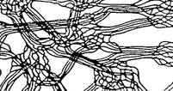
Amorphous thermoplastic polymers
Molecule chains are completely chaotically arranged and tangled with each other like the threads of a cotton wool pad
amorphous structure means that these materials cannot be subjected to loads above the glass transition point
Properties :
    Low tendency to creep
    Good dimensional stability
    Tendency to brittleness
    Sensitive to stress cracking

Slide 24
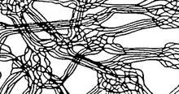
Semi-crystalline thermoplastics
Molecules form crystalline structure
Due to the crystalline areas, the materials are extremely tough (strong intermolecular forces) and are capable of withstanding mechanical loads
Properties :
    Opaque
    Good fatigue resistance
    Tendency to toughness
    Good chemical resistance
    Wear resistance

Slide 25
Some examples…

Slide 26
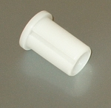
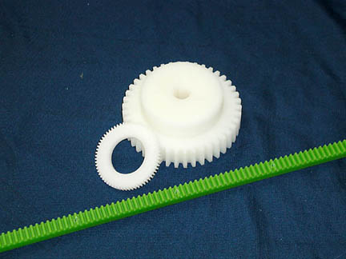

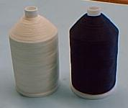


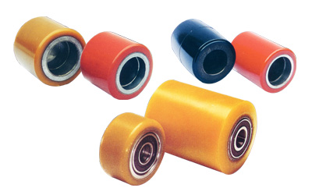
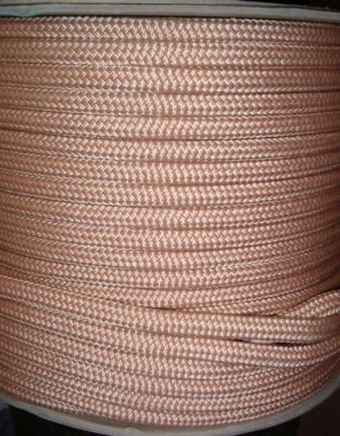
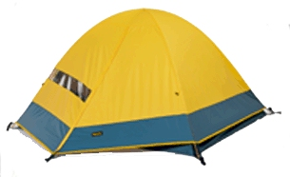
Polyamides or Nylons (PA)

Slide 27
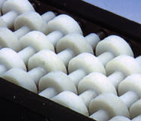
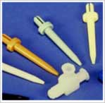
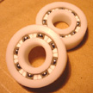

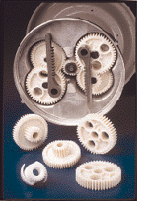
Acetals or Polyoxymethylenes (POM)

Slide 28
Acetals or Polyoxymethylenes (POM) and Polyamides characteristics
Mechanical—do not brittle, good impact strength
Moisture —very little (shower heads)
Chemical resistance—very high, resists stains, sensitive to strong acids and bases
Electrical resistance - good
Machining—like cutting brass
Adhesion—epoxy glues

Slide 29
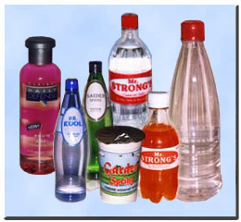

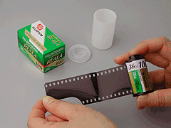
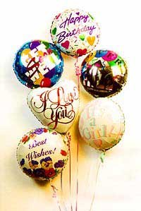


Thermoplastic Polyesters (PET/PBT)

Slide 30
Thermoplastic Polyester General Family Characteristics
PET
  Higher mechanical stiffness
  Strength by orienting chains not by H-bonding
  Get 50% crystallinity
    forced by mechanical stretching
PBT
  crystallizes rapidly
  processes faster
  lower overall properties

Slide 31

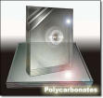
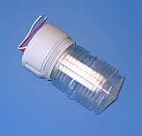
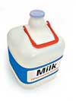
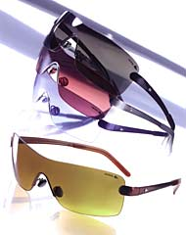
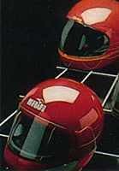

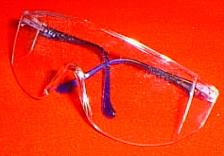
Polycarbonate

Slide 32

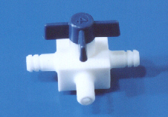
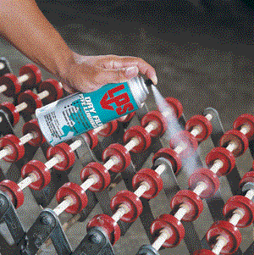
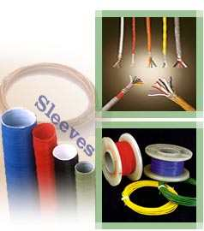
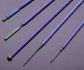
Flouropolymers

Slide 33
Processing…

Slide 34
Current Composite Materials and Processes

Slide 35
Thermoplastic − Thermoforming
Press (in two modes)
Blanks
Clampمشبك
Finished
Part
Oven
Clamping
Pressing

Slide 36
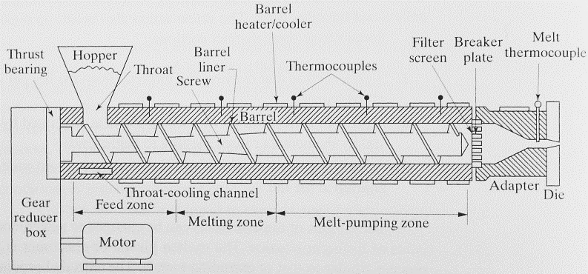
Extrusion

Slide 37
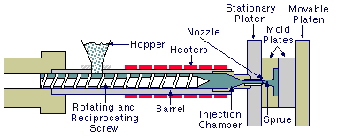
Injection Molding Machine Basics

Slide 38
Blow Molding
Plastic
Extruded Parison-
Mold Open
Mold Closed and Bottle Blown
Finished Bottle Removed from Mold

Slide 39
Compression Molding
Heat and Cooling
Platen
Mold Plunger
Guide Pins
Heat and Cooling
Mold Cavity
Compound to be molded
Platen
Hydraulic Pressure
Hydraulic Plunger

Slide 40
Future
Thermoplastics polymers go to more structural applications using different technical thermoplastics in combination with glass, carbon and synthetic fibers.
Thermoplastics will replace metal applications and reduce weight.
Improved processing methods will be developed and applied.

Slide 41
Thank you…

